Slide 1
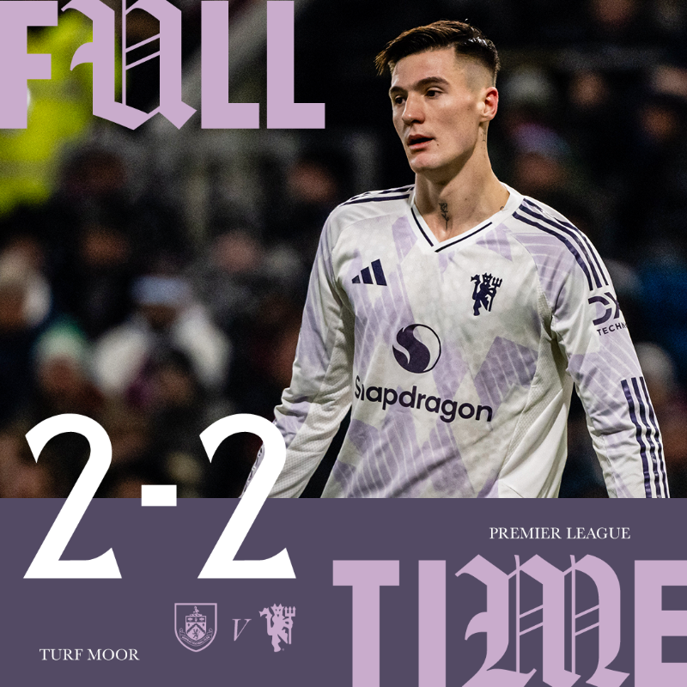
DIO RIZA PRATAMA
MAN UTD:
PERFORMANCE
ANALYSIS
BURNLEY VS UNITED
08 JAN 26
@HTTPS://X.COM/MANUTD

Slide 2
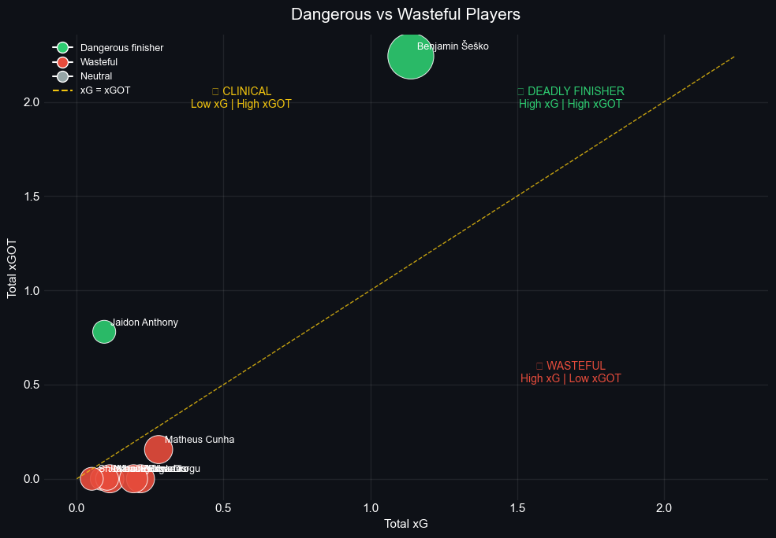
WHICH
PLAYERS OUTPERFORM THEIR
CHANCES?
FINISHING PERFORMANCE SCATTER
IN THE MATCH, TWO PLAYERS DELIVERED STANDOUT PERFORMANCES: BENJAMIN ŠEŠKO OF MANCHESTER UNITED, WHO DEMONSTRATED INTELLIGENT MOVEMENT AND IMPACTFUL CONTRIBUTIONS, AND JADON ANTHONY, WHO WAS ALSO INFLUENTIAL IN THE ATTACKING PHASES.
ON THE OTHER HAND, NO BURNLEY PLAYER WAS ABLE TO PERFORM EFFECTIVELY ENOUGH TO CREATE A NOTABLE EXPECTED GOAL (XG) THREAT THROUGHOUT THE GAME, HIGHLIGHTING THEIR LACK OF OFFENSIVE IMPACT IN THE FINAL THIRD.

Slide 3
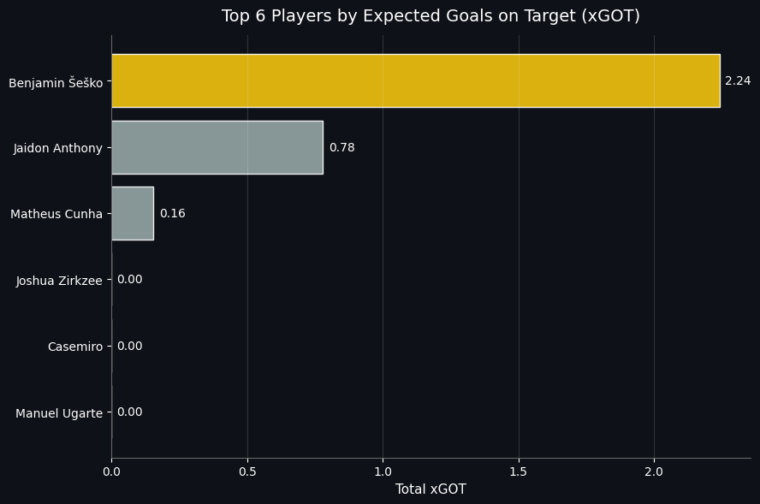

Slide 4
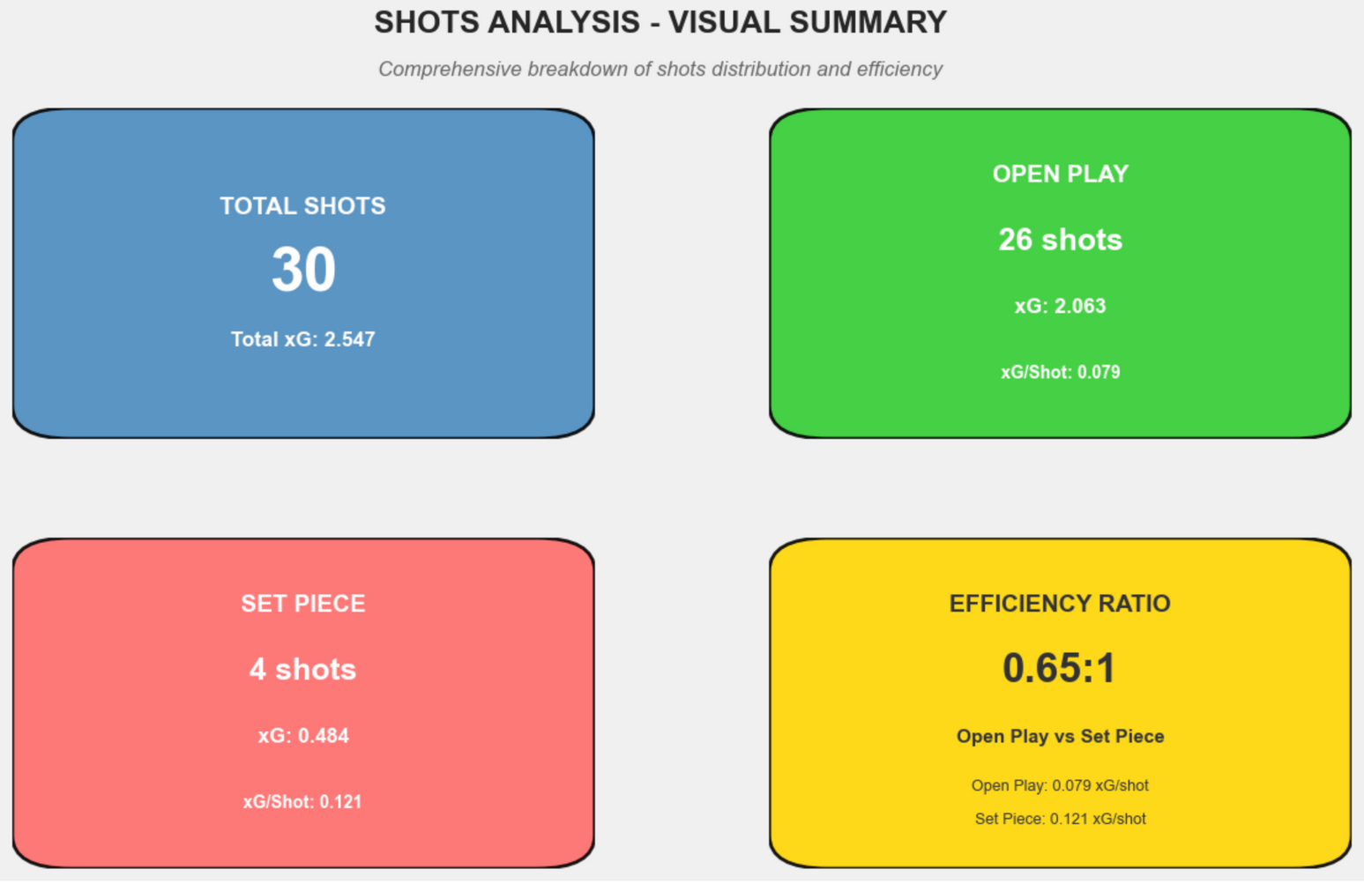
UNITED GAMEPLAY
OPEN PLAY VS SET-PIECE

Slide 5
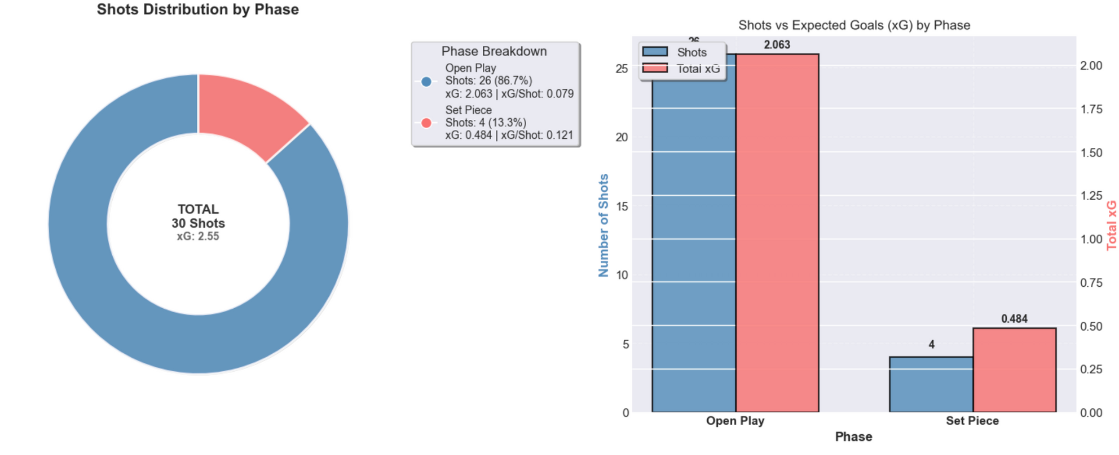
UNITED GAMEPLAY
OPEN PLAY VS SET-PIECE

Slide 6
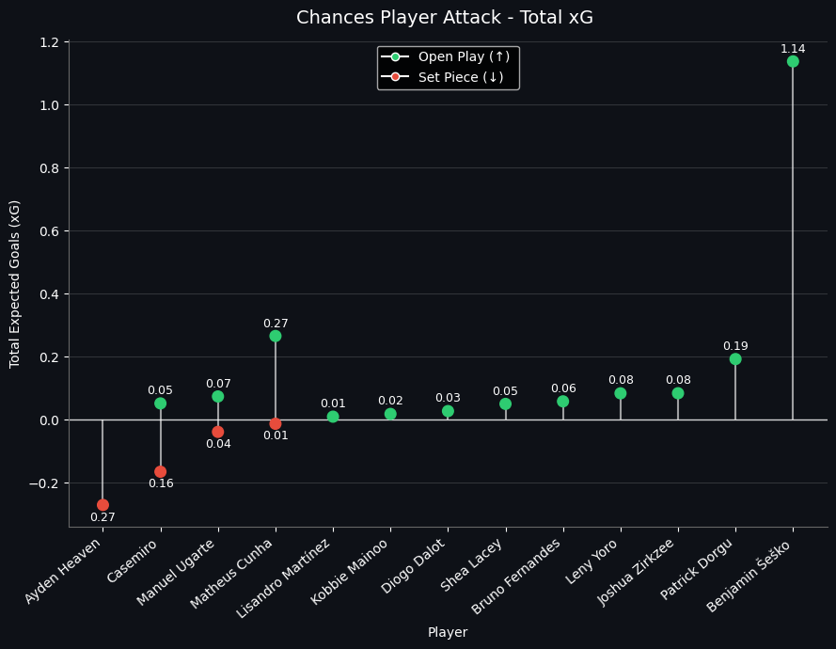
UNITED GAMEPLAY
in player chances based on xG
OPEN PLAY VS SET-PIECE

Slide 7
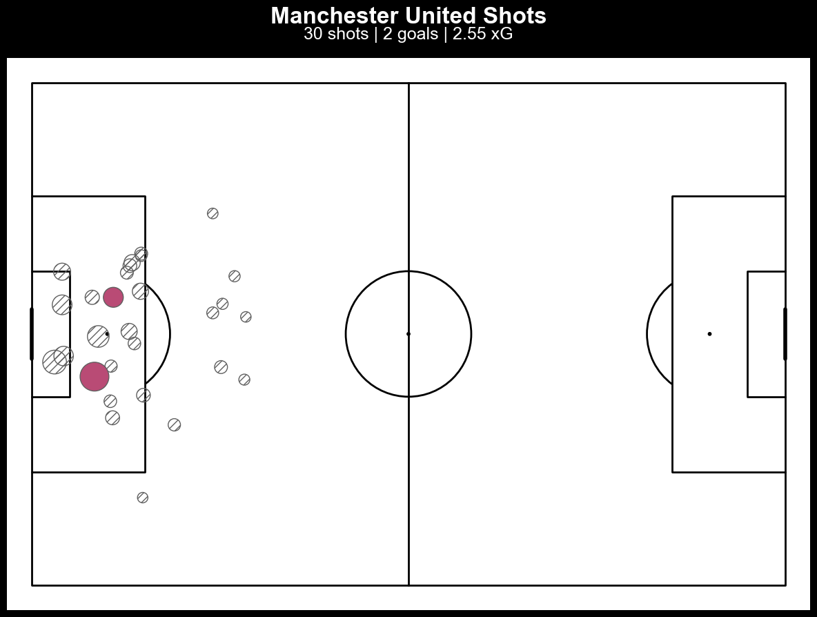
SHOTMAP
AREA

Slide 8
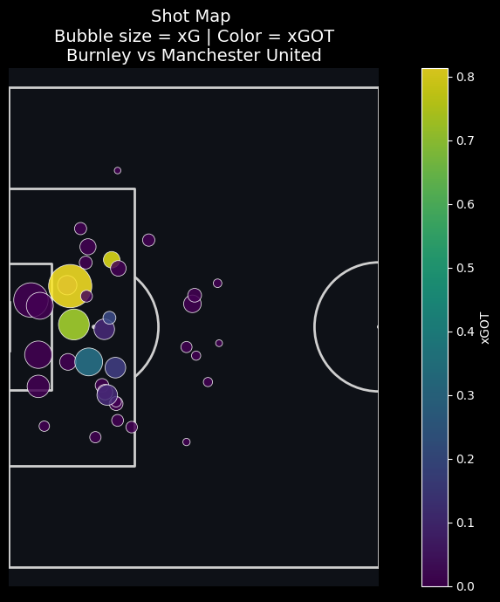
HOW DID UNITED SHOT QUALITY COMPARE TO BURNLEY?
SHOTMAP TEAM SCATTER
BASED ON THE SHOT MAP VISUALIZATION (BUBBLE SIZE = XG, COLOR = XGOT), MANCHESTER UNITED DEMONSTRATED MORE EFFICIENT CHANCE CONVERSION THAN BURNLEY.
UNITED'S SHOTS CONSISTENTLY SHOWED HIGHER XGOT VALUES (LIGHTER COLORS) RELATIVE TO THEIR XG, INDICATING THEY PLACED THEIR SHOTS WELL AND FORCED BETTER SAVES OR SCORED. IN CONTRAST, BURNLEY'S SHOTS GENERALLY HAD XGOT VALUES CLOSE TO OR LOWER THAN THEIR XG (DARKER COLORS), REFLECTING POORER FINISHING OR LESS THREATENING ATTEMPTS ON TARGET.

Slide 9
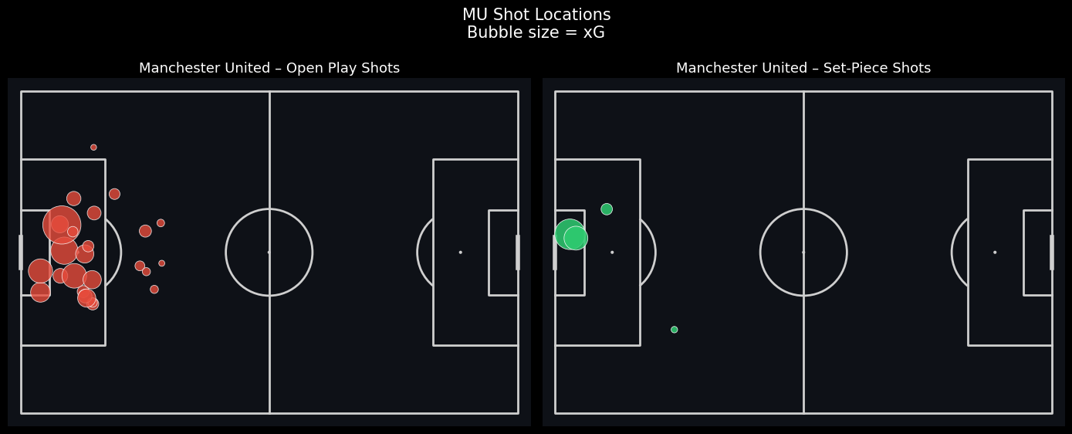
SHOTMAP
OPEN PLAY VS SET-PIECE

Slide 10
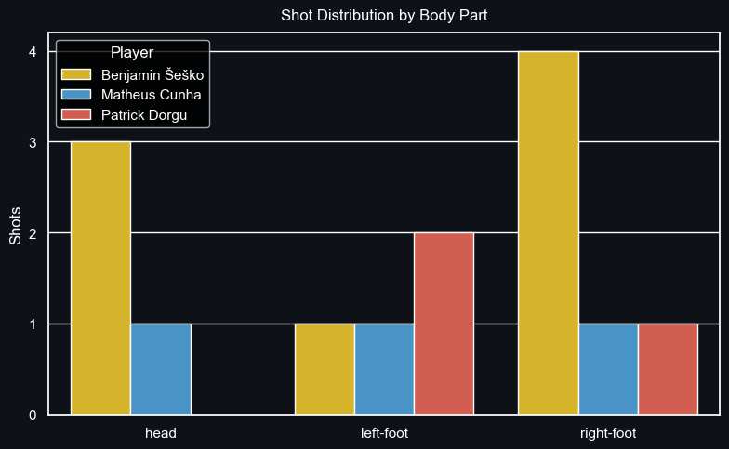
DIAGRAM SHOT DISTRIBUTION

Slide 11
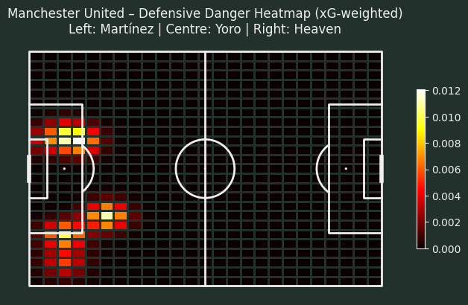
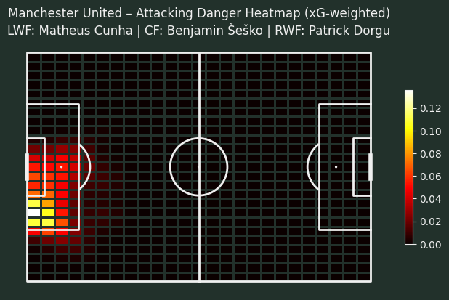
UNITED
HEATMAP
DEFEND VS ATTACK

Slide 12
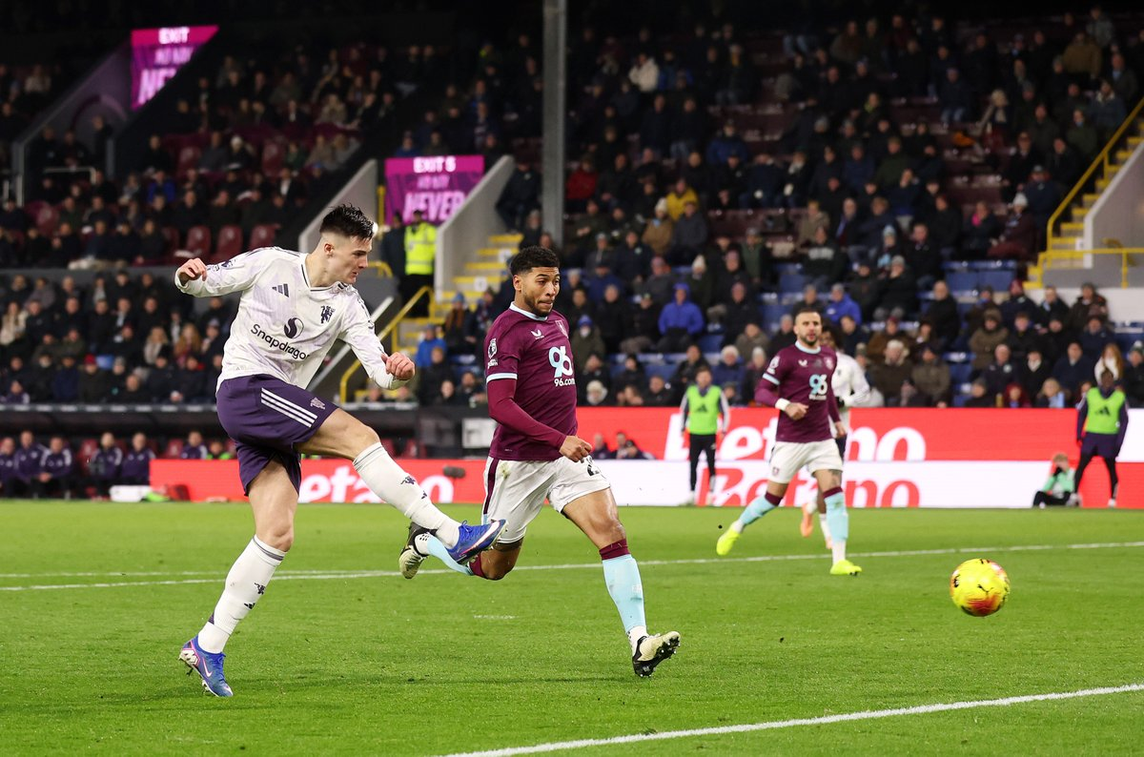
TACTICAL MOVE
MANCHESTER UNITED 4-2-3-1 FORMATION WITH INTERIM COACH, MANCHESTER UNITED DOMINATED THE MATCH STATISTICALLY WITH 65% POSSESSION AND 30 SHOTS, BUT THEIR PERFORMANCE WAS DEFINED BY EXTREME INEFFICIENCY IN ATTACK. THEY CREATED HIGH-QUALITY CHANCES (5 BIG CHANCES, 2.55 XG) YET FAILED TO CONVERT THEM, SCORING ONLY ONCE. THE TACTICAL SETUP CONTROLLED THE GAME BUT LACKED SHARP, CREATIVE MOVEMENT TO DECISIVELY BREAK DOWN BURNLEY'S DEEP BLOCK, RESULTING IN A NARROW AND UNCONVINCING 1-0 WIN THAT SHOULD HAVE BEEN FAR MORE COMFORTABLE.
MAN UNITED

Slide 13
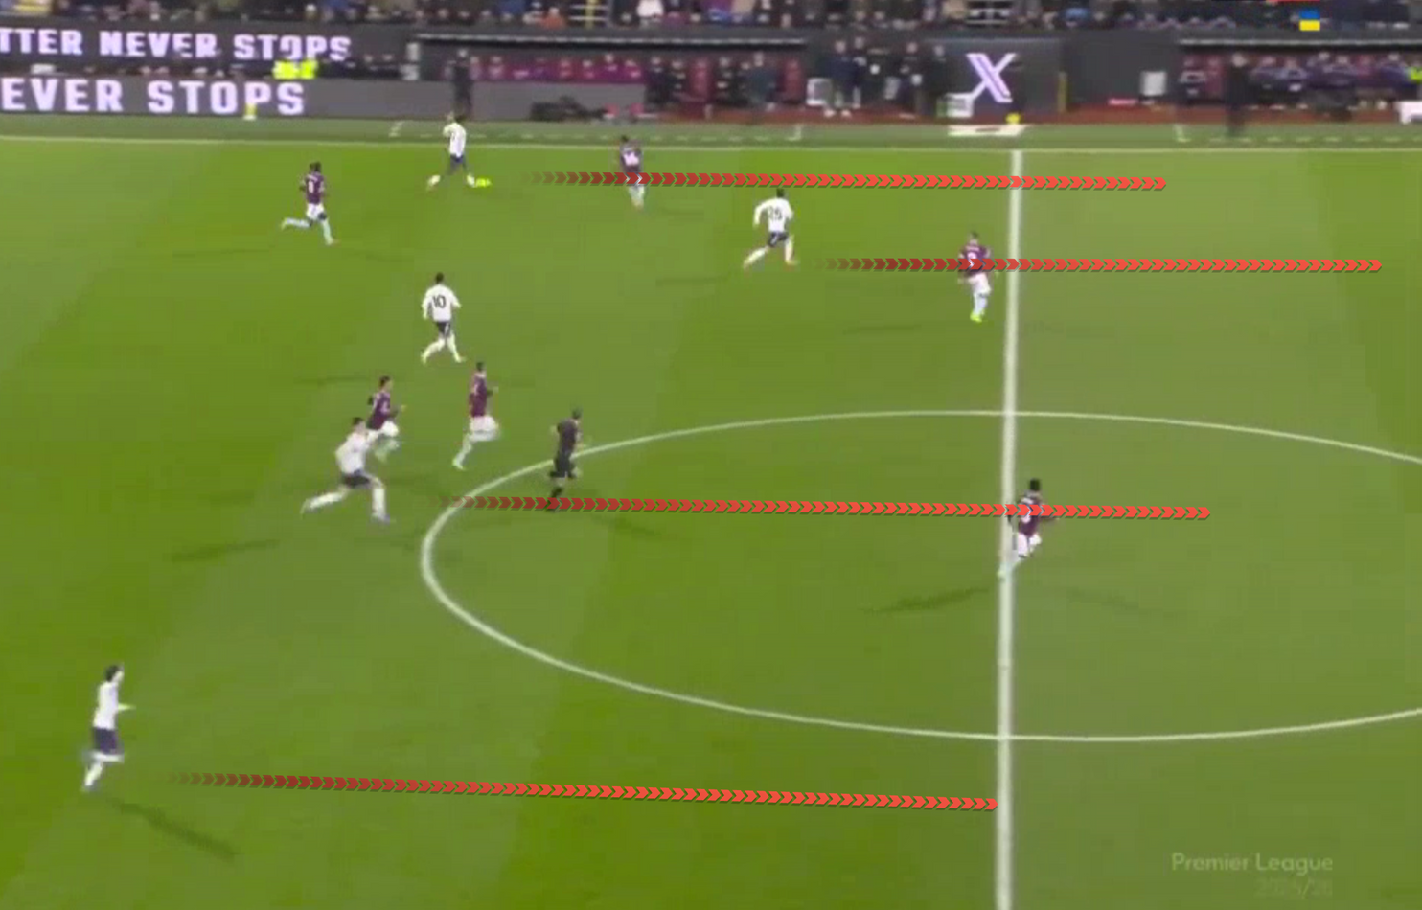
COUNTER ATTACK POSITIONING
MANCHESTER UNITED COUNTER-ATTACK POSITIONING AGAINST BURNLEY WAS STRUCTURED AROUND A QUICK TRANSITION FROM A COMPACT MID-BLOCK. UPON WINNING POSSESSION, THEY UTILIZED DIRECT VERTICAL PASSES INTO SPACE, WITH WINGERS POSITIONED HIGH AND WIDE TO EXPLOIT GAPS BEHIND BURNLEY'S ADVANCED FULL-BACKS. A CENTRAL FORWARD ACTED AS A PIVOT FOR LINK-UP PLAY, WHILE OVERLAPPING FULL-BACKS PROVIDED WIDTH AND DELIVERY INTO THE BOX, CREATING NUMERICAL ADVANTAGES ON THE FLANKS TO CAPITALIZE ON BURNLEY'S DEFENSIVE VULNERABILITIES DURING TRANSITION.

Slide 14
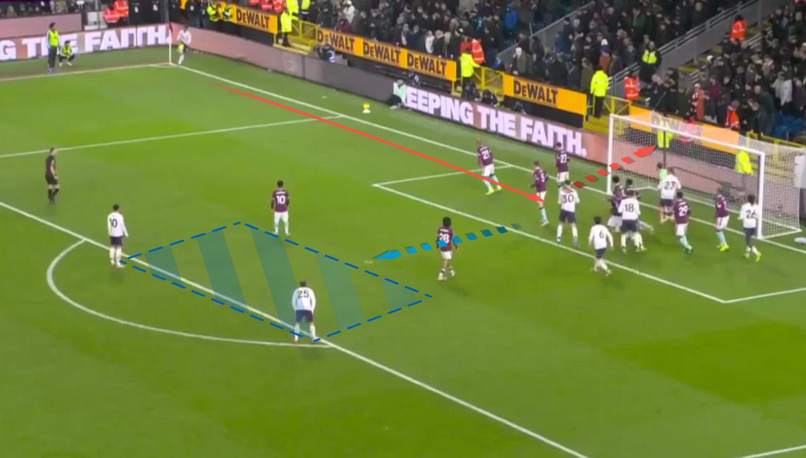
SET-PIECE SCHEME
SECOND BALL TARGET
THIS SET-PIECE HIGHLIGHTS MANCHESTER UNITED’S APPROACH OF PRIORITIZING SECOND-BALL CONTROL RATHER THAN DIRECT AERIAL DUELS. THE PRIMARY OBJECTIVE IS TO CAPITALIZE ON REBOUNDS OR PARTIAL CLEARANCES, CREATE SHOOTING ANGLES FOR SECOND-LINE PLAYERS, AND AVOID CONTESTED AERIAL BATTLES DOMINATED BY WOLVES’ DEFENDERS. OVERALL, IT REFLECTS A DELIBERATE STRATEGY TO GENERATE SHOOTING OPPORTUNITIES FROM STRUCTURED SET-PIECE CHAOS RATHER THAN RELYING SOLELY ON CROSSES INTO A CROWDED BOX.

Slide 15
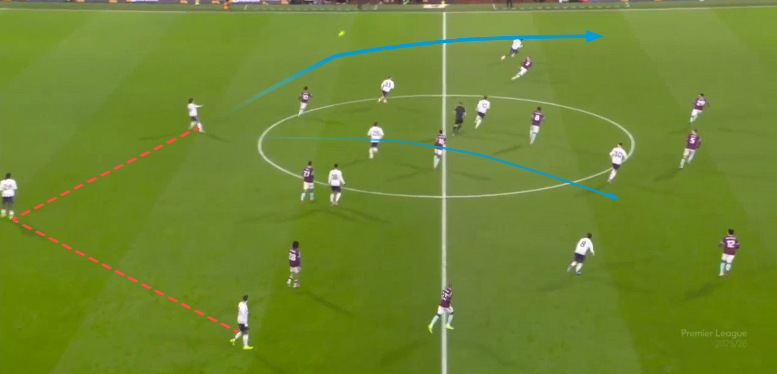
CHANCE QUALITY
TWO AVAILABLE PROGRESSION OPTIONS
THE CHANCE CREATED BY MARTINEZ IN THE 53RD MINUTE DEMONSTRATED CLEAR AND DIRECT VISION. HE EXECUTED A LONG, FLOATED THROUGH BALL FORWARD TOWARDS BRUNO FERNANDES, WHICH UNFORTUNATELY STRUCK THE CROSSBAR. MARTINEZ IDENTIFIED DORGU IN SPACE, BUT ALSO HAD THE ALTERNATIVE OPTION OF A PASS TO BRUNO, PRESENTING TWO CLEAR AND VIABLE PASSING LANES.

Slide 16
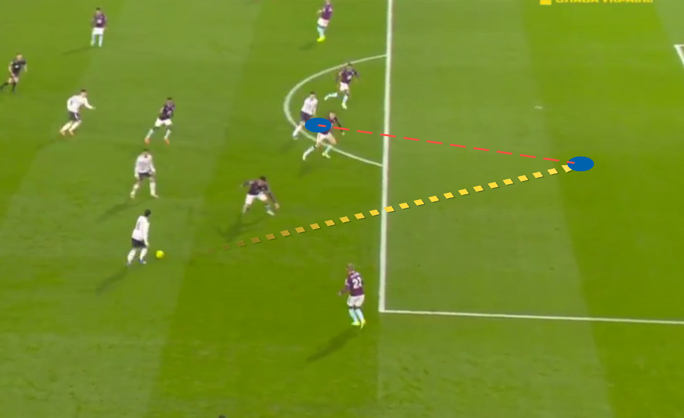
GOAL CREATED
IN THE 50TH MINUTE, A DECISIVE ATTACKING SEQUENCE UNFOLDED. SESKO INTELLIGENTLY DRIFTED INTO SPACE, DRAGGING DEFENDERS WITH HIM AND DISRUPTING THE OPPOSITION'S DEFENSIVE STRUCTURE. THIS MOVEMENT CREATED THE CRUCIAL OPENING FOR BRUNO FERNANDES TO EXPLOIT. RECEIVING THE BALL IN A DANGEROUS AREA, BRUNO CAPITALIZED ON THE OPPORTUNITY BY CLINICALLY FINISHING PAST THE GOALKEEPER TO SCORE. HE WAS ALSO CREDITED WITH THE ASSIST FOR HIS ROLE IN THE BUILD-UP, COMPLETING A KEY GOAL CONTRIBUTION THAT SHOWCASED EFFECTIVE OFF-THE-BALL MOVEMENT AND PRECISE EXECUTION.
THE TACTICAL VISION AND MOVEMENT PATTERN BETWEEN BRUNO FERNANDES AND SESKO. WHERE THE STRIKER CREATES SPACE FOR THE MIDFIELDER TO PENETRATE HAS BEEN ATTEMPTED MULTIPLE TIMES IN PREVIOUS MATCHES, THE ON-FIELD CHEMISTRY AND SYNCHRONIZATION NECESSARY FOR ITS CONSISTENT SUCCESS HAVE NOT YET FULLY DEVELOPED. THE TIMING OF THE RUNS, THE WEIGHT OF THE PASSES, AND THE MUTUAL UNDERSTANDING IN DECISIVE MOMENTS ARE STILL A WORK IN PROGRESS, PREVENTING THE COMBINATION FROM BECOMING A RELIABLY PRODUCTIVE WEAPON FOR THE TEAM.

Slide 17
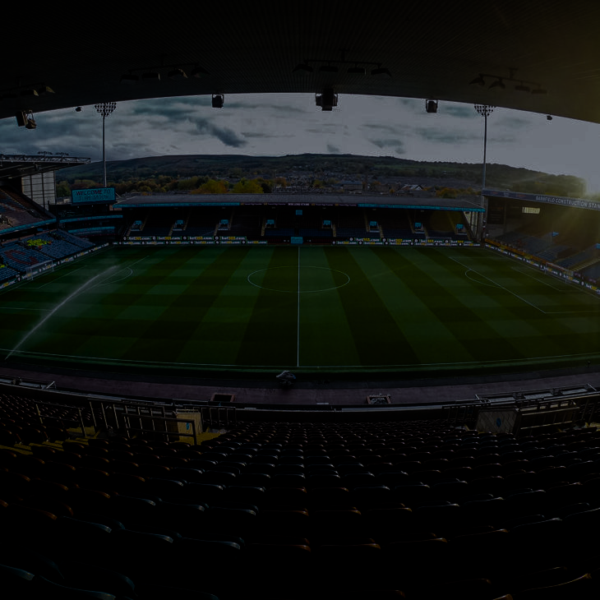
STATISTICAL INSIGHT
DISTRIBUTION:
OPEN PLAY: 26 SHOTS (86.7%)
SET PIECE: 4 SHOTS (13.3%)
EXPECTED GOALS (XG):
TOTAL XG: 2.547
Open Play xG: 2.063
SET PIECE XG: 0.484
EFFICIENCY (XG PER SHOT):
• SHOT DIFFERENCE: 22 MORE SHOTS FROM OPEN PLAY
• XG DIFFERENCE: 1.579 MORE XG FROM OPEN PLAY
• EFFICIENCY DIFFERENCE: -0.042 XG/SHOT
KEY INSIGHTS:
→ SET PIECE SHOTS ARE MORE EFFICIENT THAN OPEN PLAY
→ TEAM HEAVILY RELIES ON OPEN PLAY FOR CREATING CHANCES
→ 86.7% OF ALL SHOTS COME FROM OPEN PLAY

